Slide 1
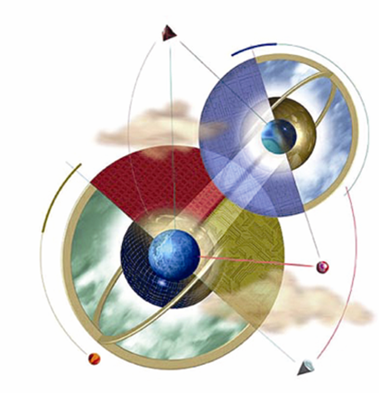
Chapter 1:
Introduction to Expert Systems
Expert Systems: Principles and Programming, Fourth Edition

Slide 2
Objectives
Learn the meaning of an expert system
Understand the problem domain and knowledge domain
Learn the advantages of an expert system
Understand the stages in the development of an expert system
Examine the general characteristics of an expert system

Slide 3
Objectives
Examine earlier expert systems which have given rise to today’s knowledge-based systems
Explore the applications of expert systems in use today
Examine the structure of a rule-based expert system
Learn the difference between procedural and nonprocedural paradigms
What are the characteristics of artificial neural systems

Slide 4
What is an expert system?
“An expert system is a computer system that emulates, or acts in all respects, with the decision-making capabilities of a human expert.”
Professor Edward Feigenbaum
Stanford University

Slide 5
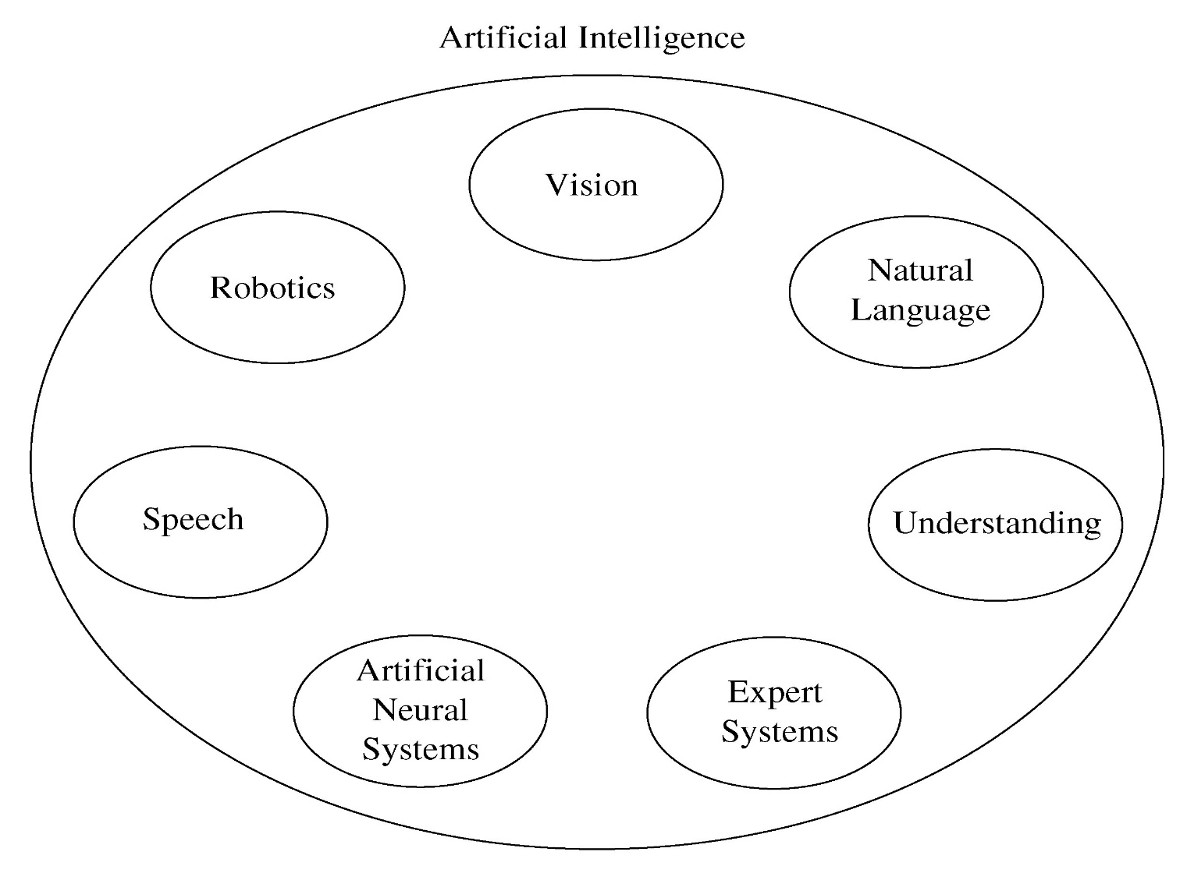
Fig 1.1 Areas of Artificial Intelligence

Slide 6
Expert system technology may include:
Special expert system languages – CLIPS
Programs
Hardware designed to facilitate the implementation of those systems

Slide 7
Expert System Main Components
Knowledge base – obtainable from books, magazines, knowledgeable persons, etc.
Inference engine – draws conclusions from the knowledge base

Slide 8
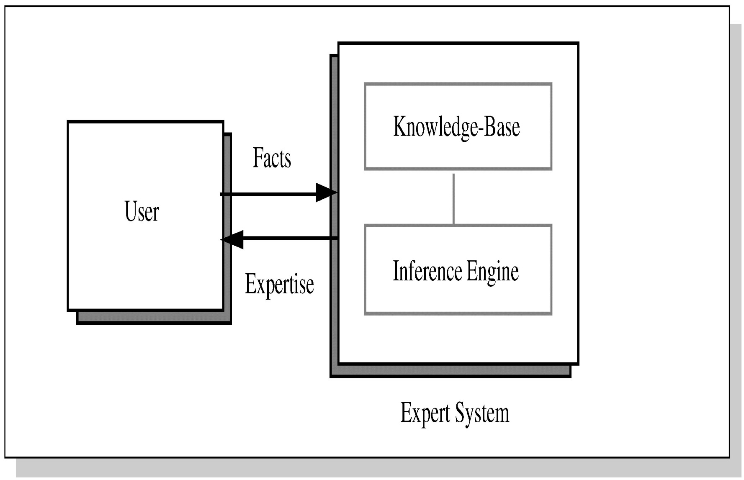
Figure 1.2 Basic Functions of Expert Systems

Slide 9
Problem Domain vs. Knowledge Domain
An expert’s knowledge is specific to one problem domain – medicine, finance, science, engineering, etc.
The expert’s knowledge about solving specific problems is called the knowledge domain.
The problem domain is always a superset of the knowledge domain.

Slide 10
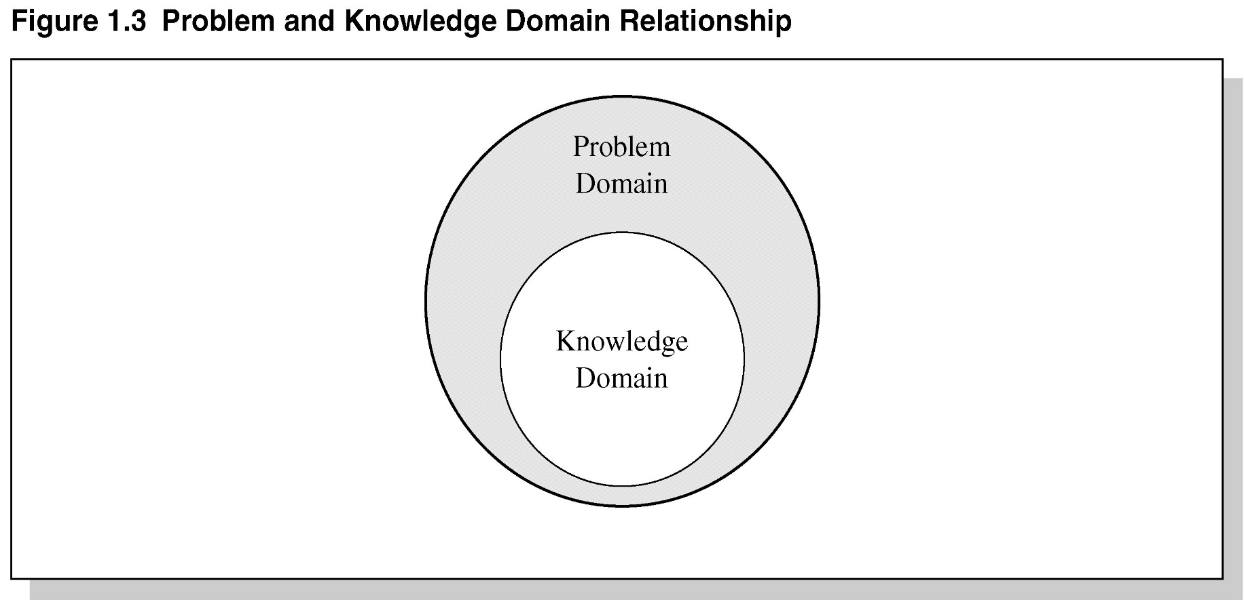
Figure 1.3 Problem and Knowledge Domain Relationship

Slide 11
Advantages of Expert Systems
Increased availability
Reduced cost
Reduced danger
Performance
Multiple expertise
Increased reliability

Slide 12
Advantages Continued
Explanation
Fast response
Steady, unemotional, and complete responses at all times
Intelligent tutor
Intelligent database

Slide 13
Representing the Knowledge
The knowledge of an expert system can be represented in a number of ways, including IF-THEN rules:
IF you are hungry THEN eat

Slide 14
Knowledge Engineering
The process of building an expert system:
The knowledge engineer establishes a dialog with the human expert to elicit knowledge.
The knowledge engineer codes the knowledge explicitly in the knowledge base.
The expert evaluates the expert system and gives a critique to the knowledge engineer.

Slide 15
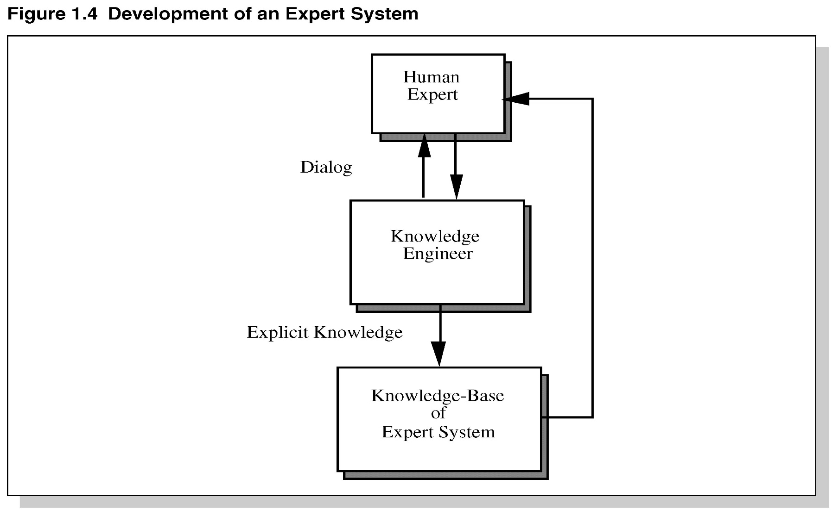
Development of an Expert System

Slide 16
The Role of AI
An algorithm is an ideal solution guaranteed to yield a solution in a finite amount of time.
When an algorithm is not available or is insufficient, we rely on artificial intelligence (AI).
Expert system relies on inference – we accept a “reasonable solution.”

